Slide 1
Samples: UnitedHealthcare Vision Website Enhancements
March 2014

Slide 2
Vision Website Enhancements Coming Soon
The member’s online experience is being enhanced with the launch of Vision Administration System
Enhancements include:
  Single sign on from myuhc.com
  Consistent look and feel between the two websites, myuhc.com and myuhcvision.com
  Ability for the subscriber to see the claims/eligibility for the whole family through one login
  Online Explanation of Benefits (EOB)
Mobile device compatibility that allows members to view and share an online ID card with their provider at the point of service from their mobile device

Slide 3
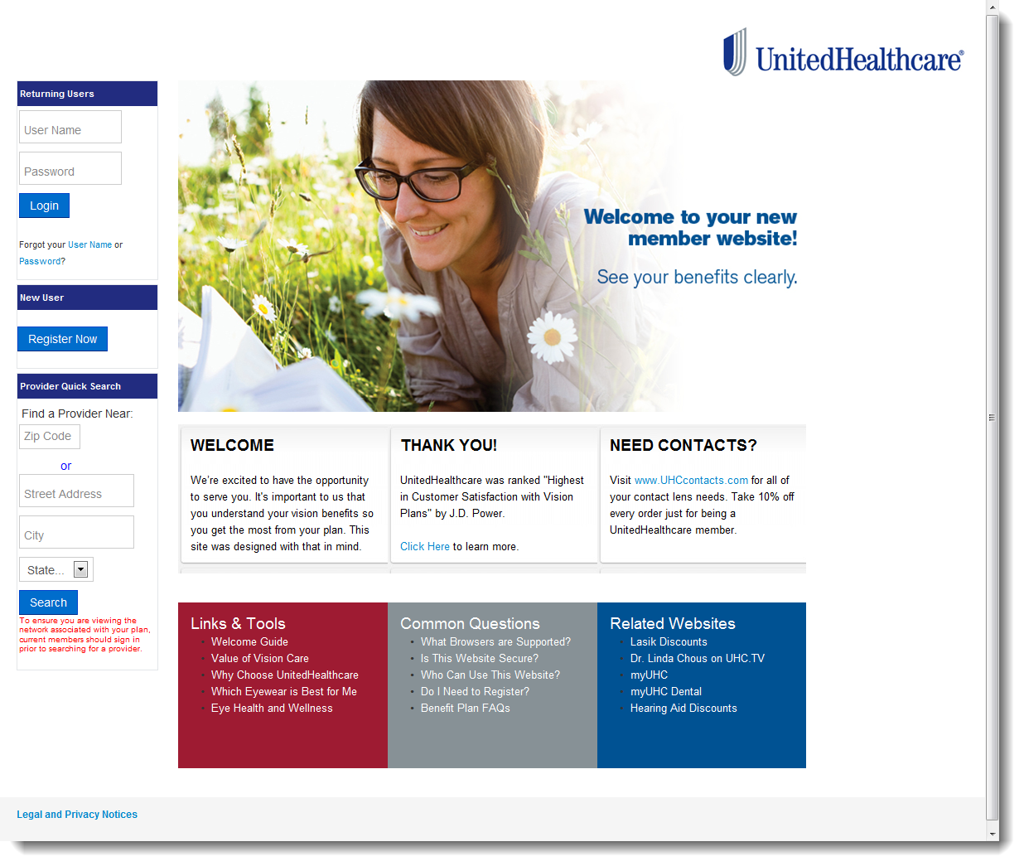
Vision Online Enhancements – Member Home Page, Pre-login

Slide 4
Vision Online Enhancements – Member Home page, Post-login
Easy access to helpful information from home or mobile device

Slide 5
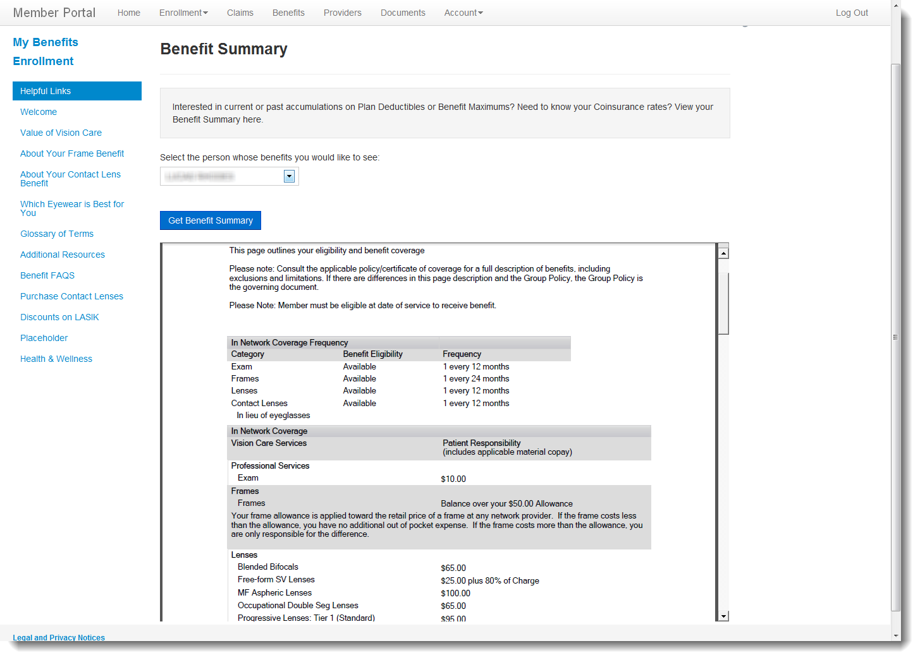
Vision Online Enhancements – Detailed Benefit Information

Slide 6
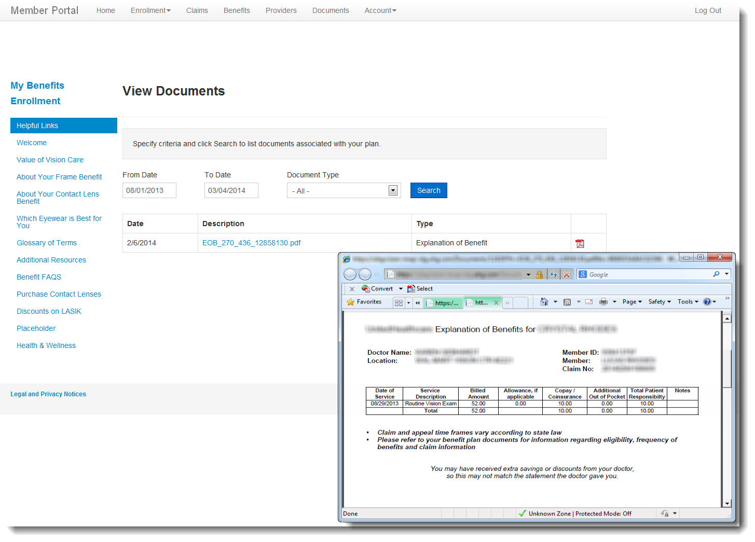
Vision Online Enhancements – Explanation of Benefits (EOB)

