Slide 1
Self-care: Small Changes for Positive Results
Workbook

Slide 2
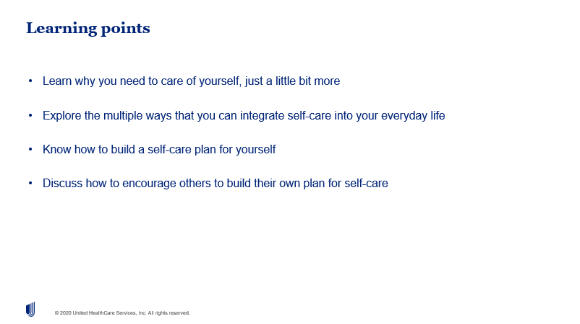
Before we begin, please make notes about what you would specifically like to learn about today?
Is there anything in particular that you are interested to explore?

Slide 3
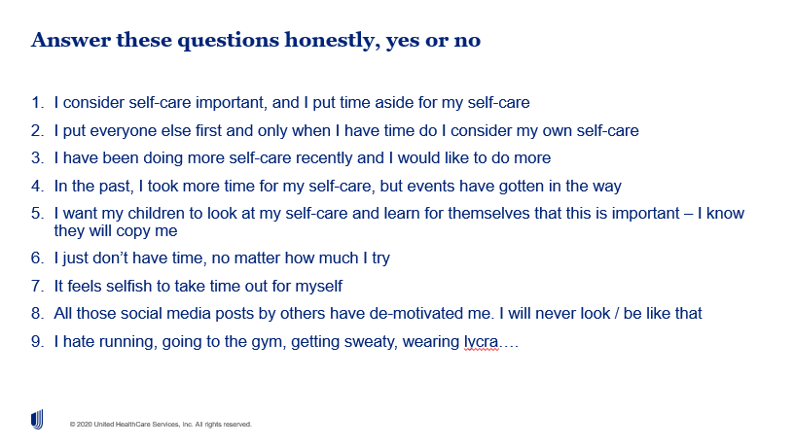
What does this reveal about your attitudes to self-care?
What are your hopes and fears for this program?
What practical arrangements get in the way?

Slide 4
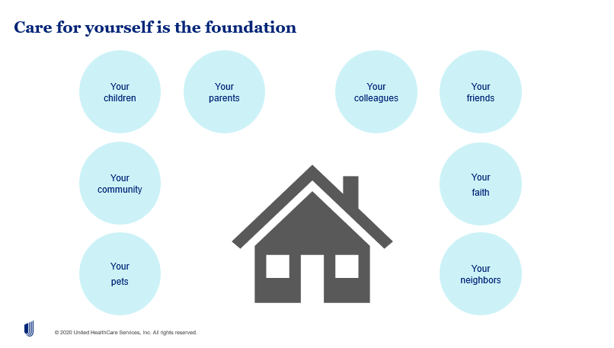
Make notes about who / what relies on you?
If something happened to you, what would happen to them?
Make notes about how you feel about self-care as a foundation for health and happiness?

Slide 5
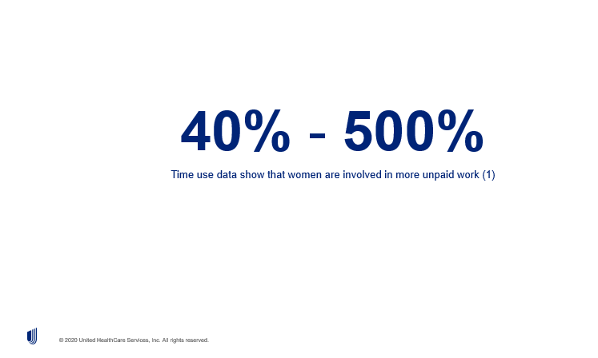
Please make any notes here:
(1) Hirway, I. (2015). Unpaid work and the economy: Linkages and their implications. https://doi.org/10.1007/s41027-015-0010-3

Slide 6
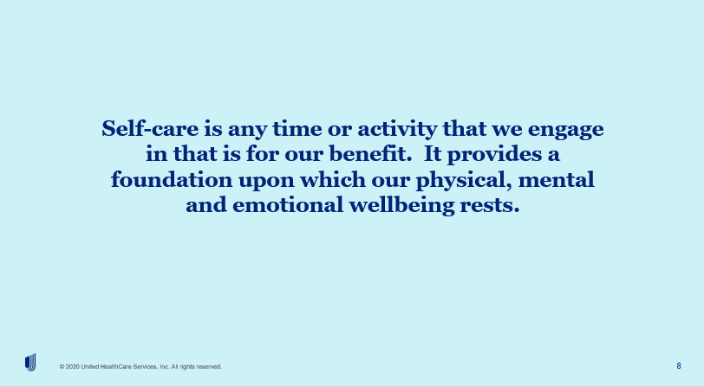
What are the activities in your life that leave you feeling more energized?
What are the activities in your life that leave you feeling depleted?

Slide 7

The approach we are encouraging you to take is:
5 minute chunks of self-care
5 times a day or 5 days a week
What do you spend five minutes doing now, that you could give up? E.g. a little less time on social media; e.g. a little less time watching videos? What else?

Slide 8
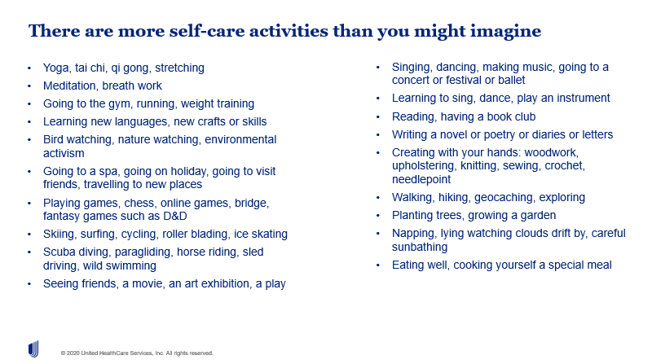
What is missing?
Which ideas get you excited?
Which activities could you add into your life?
What would give you most energy?
Which activities would make you feel alive and refreshed?

Slide 9
Make your plan here:
Choose five times a day: morning, mid morning, lunch, mid afternoon, evening
Or Choose five days a week: M, T, W, T, F, S, S
Choose activities to fit INTO those parts of your day/week
Consider what you are already doing that you could combine with snippets of self-care

Slide 10

If it is true, you can say ‘I worry you are not looking after yourself’ and leave a pause and wait. They may be grateful to know that you care.
If it is a colleague or family member, maybe direct them to Optum services
Make other notes here:

Slide 11
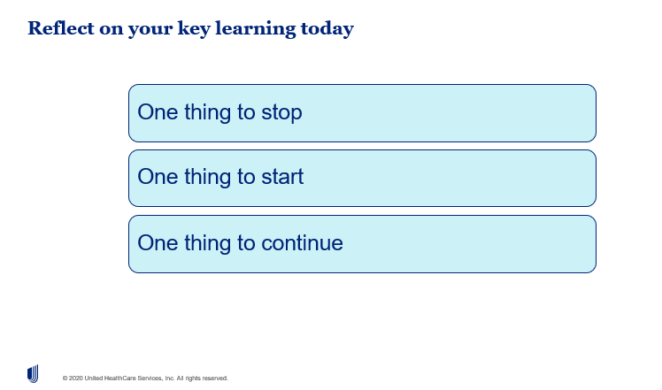
Make any personal notes here:
One thing to stop:
One thing to start:
One thing to continue:

Slide 12
About professional support
You may consider seeking professional support if you experience any of the following:
  Sleep problems.
  Performance issues at work.
  Relationship difficulties with family or friends.
  Loss of interest in hobbies you normally enjoy.
  Lack of care about normal everyday work tasks.
  Excessive anxiety or worrying more than normal.
  Feeling overwhelmed or sad for more than two weeks.
  A noticeable change in appetite, eating too little or too much.
  Behaviour and coping methods have become harmful to yourself or others, whether that is through aggressive behaviour or unhealthy habits, such as alcohol or drug misuse.
  Thoughts of harm to self and/or others.
Keep in mind some of these conditions may warrant more urgent professional help and you should seek support if you are unsure.

